Slide 1
Parallel Implementation of CNN for Visual Search and Product Recommendation
Jen Jose Jeeson - 2023BCS0017 Jefin Francis - 2023BCS0053

Slide 2
Project Idea
Our project aims to speedup the training of visual search system used for recognizing and categorizing product images by parallelizing the training process of CNN. The core of the product identifying system is a Convolutional Neural Network (CNN) which while highly effective for identifying products from user uploaded images, is computationally demanding during training. To overcome this heavy computational load and improve training speed on a CPU, we are specifically optimizing the CNN training using OpenMP parallelization for efficient parallel execution.

Slide 3
How we achieved it?
01
02
03
04
We first built a serial Convolutional Neural Network (CNN) in C++ to classify product images into categories
We analyzed the CNN workflow to find the most time-consuming parts, mainly the convolution, pooling, and backpropagation operations.
Using OpenMP directives like #pragma omp parallel for, we parallelized these key sections to allow multiple CPU threads to work simultaneously, improving training and inference speed.
Nested loops within the CNN layers (specifically, the convolution layer) were also parallelized.

Slide 4
Areas of Parallelization
01
02
03
04
The Main Training Loop: The primary for loop that iterates over the entire set of training samples (train_cnt) was parallelized using #pragma omp parallel for. This allowed different threads to process different images concurrently.
Layer-Level Computations (Convolution): You implemented layer-level parallelization, specifically targeting the highly intensive nested loops inside the convolution layer using #pragma omp parallel for collapse(2).
Forward Pass: The forward_pass function , which performs the core CNN calculations (like convolution, activation, and pooling), was executed within the parallelized main loop.
Backpropagation: The back_pass function, which is responsible for calculating the error and applying the gradients to update the network's weights, was also called inside the parallelized training loop

Slide 5
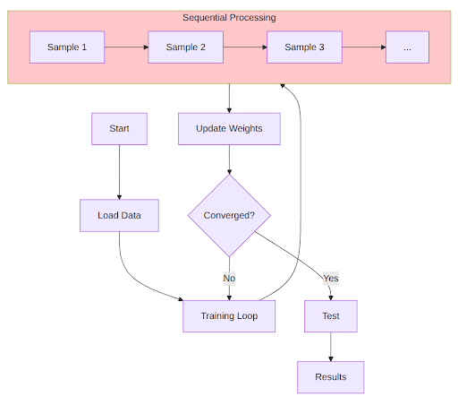
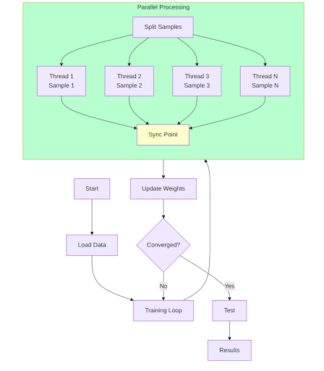
Diagram

Slide 6
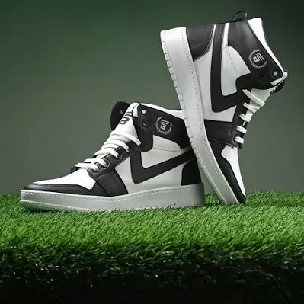

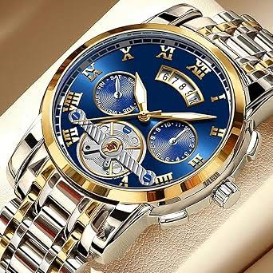
Our Dataset (training data)
We downloaded around 1000 pictures each for three categories (shoes, belts and watches). These pictures are

Slide 7


Our Results
Num of threads | Exec Time (in sec) | Error(%)
1 | 49.504121 | 16.13
2 | 39.714785 | 16.13
4 | 39.583523 | 18.51
8 | 60.294790 | 19.92

Slide 8
Observation
01
Optimal Performance: The best overall execution time was achieved when using 4 threads.
02
Performance Degradation: Performance became worse than sequential when using 8 threads.
03
Reason: This performance decrease is due to communication and synchronization overhead between the threads, which outweighed the computational gains provided by our Parallelization.
04
Error Rate: The parallel implementation showed a linear effect on increasing the error rate as threads increased, suggesting a trade off between speed and accuracy.

Slide 9
Conclusion
The project successfully demonstrated that OpenMP based parallelization can be used to accelerate CNN training and testing on a multi core CPU.The execution time was reduced from 49.5 seconds (sequential) to 39.58 seconds (4 threads).
Future works on this project could involve implementing multi node distributed training using MPI, using CUDA for Nvidia GPU based acceleration, applying this approach on a real time e commerce platform , and integrating this training logic into advanced ML frameworks like Tensorflow and Pytorch.

Slide 10
THANK YOU

